Slide 1
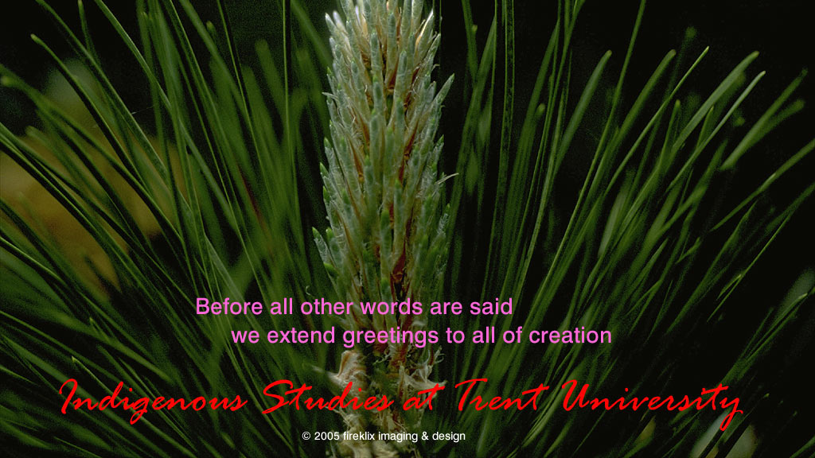

Slide 2
Indigenization
Reconciliation, Faculty Associations, and Collective Agreements

Slide 3
David Newhouse
Chair, CAUT Aboriginal Working Group
Grievance Officer, Trent University Faculty Association
Professor and Director, Chanie Wenjack School for Indigenous Studies
Co-Chair, SSHRC Indigenous Advisory Committee
Science Officer, CIHR Indigenous Health Research Adjudication Committee

Slide 4
The Long Assault
1857
An Act to Encourage the Gradual Civilization of the Indian tribes in this province and to amend the laws respecting Indians
1969
The Statement of Indian Policy of the Government of Canada
Aka The White Paper
Withdrawn 1971

Slide 5
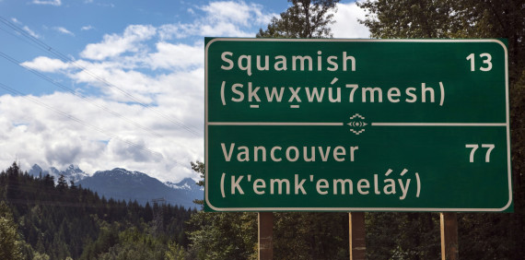
Reconciliation
The largest national project
since the building of the
National Railway
Underway since 1971, officially 2015

Slide 6
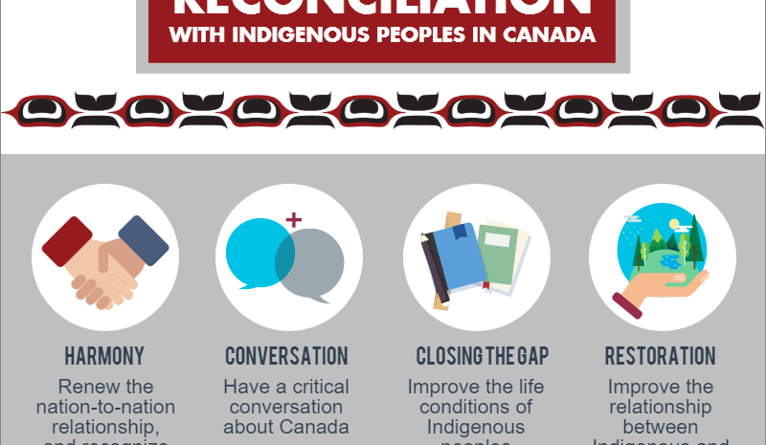
Reconciliation
Multi-actor
Multi-site
Multi-Actor
Multi-Generation
Complex
Process and Project

Slide 7
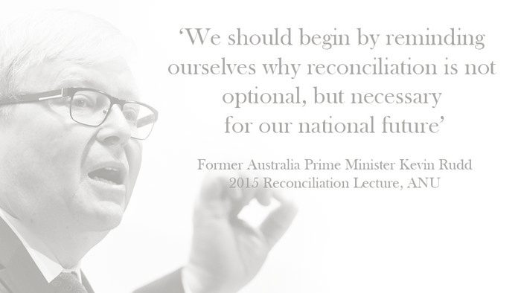
Reconciliation doesn’t just happen
Requires political commitment at all levels
Requires collective action
Requires sustained effort over time
Requires willingness to experiment and try new things
Requires good will

Slide 8
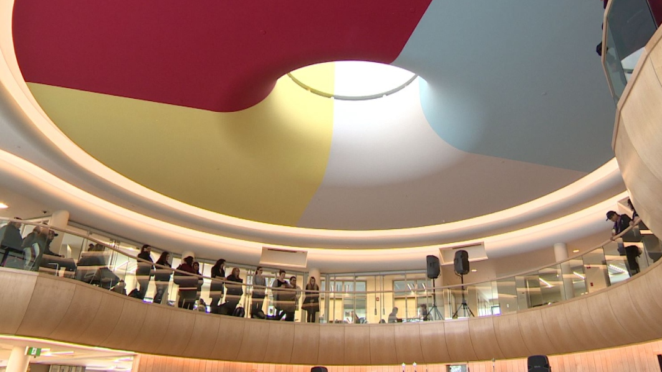
Indigenization
Indigenization
It’s not just ‘add Indigenous and stir’
It’s a world view. It takes a long time to learn how to do it respectfully, even for those of us who are Indigenous.
Priscella Settte
Professor of Indigenous Studies
University of Saskatchewan
CBC News, Sept 23, 2017

Slide 9

Indigenization Areas of Effort
Land Acknowledgements
Students
Spaces
Academic Programs
Indigenous Knowledge
Faculty
Senior Adminstrators
Committees
Indigenization Plans

Slide 10
Indigenization Elements
Students
Spaces
Programs
Faculty
Knowledge
Governance
Founded on principle of Indian Control of Indian Education, 1972
Non–linear site phased approach
Institutions can in different phases at the same time

Slide 11
University Indigenization
Significant increase in hiring of Indigenous faculty
Social sciences, humanities, sciences,
Education, law, health, business
Mostly beyond Indigenous Studies
Both individual hires and cluster hires
Response to TRC report and Universities Canada statements

Slide 12
University Indigenization
Demand for Indigenous faculty exceeds demand
Extremely competitive
Complement still very small: 1.5%
Reports from CAUT conference of significant challenges
  Hostile and/or unsupportive colleagues
  High service and representative demands on university committees
  Assumption of admin responsibilities at early career stage, sometimes prior to tenure
  Lack of understanding and/or support for research, often community based
  Biased or prejudiced teaching reviews

Slide 13

Indigenization
Guidance
Documents
TRC Calls to Action
University Canada Principles of Indigenous Education
CAUT Policy Statement
SSHRC Indigenous Research
Individual University Plans
CAUT Bargaining Advisory

Slide 14
CAUT Policy Statement on Indigenizing the Academy
November 2016
entails a recognition of historic wrongs committed against First Nations, Inuit, and Métis communities in Canada, and
a commitment to undertake proactive measures aimed at restoring, renewing, and re­generating Indigenous practices, languages, and knowledge

Slide 15
CAUT Policy Statement on Indigenizing the Academy
November 2016
Indigenizing may require employers and academic staff associations to negotiate appropriate amendments to their collective agreements, or terms and conditions of employment, with a view to establishing equitable policies and practices that involve Aboriginal Peoples and Indigenous Knowledge in all aspects of campus life.

Slide 16
CAUT Policy Statement on Indigenizing the Academy
November 2016
Explicit recognition that Aboriginal academic staff must, at minimum, enjoy equal rights with regard to association or union membership, academic freedom, decent working conditions, fair compensation, and access to resources for research and teaching.
Commitment to an ongoing and permanent expansion of the Aboriginal academic staff complement, including both targeted hires to existing positions and the establishment of new regular positions which contribute to the long-term growth of Aboriginal teaching, research, and community service within the academy.

Slide 17
CAUT Policy Statement on Indigenizing the Academy
November 2016
Mechanisms for the fair, transparent, and peer-directed hiring of Aboriginal academic staff.
Provision of appropriate career training and support, in order to ensure fairness in the retention and promotion of Aboriginal academic staff.

Slide 18
CAUT Policy Statement on Indigenizing the Academy
November 2016
Explicit recognition, in all Aboriginal academic staff hiring, training, and evaluation procedures, of special qualifications and contributions including: development and sharing of Indigenous knowledge and languages; engagement with culturally appropriate research and publication venues; community service; and any other relevant considerations, including lived experiences within Aboriginal communities.
Explicit recognition of, and appropriate compensation for, any increased workload that may be taken on by Aboriginal academic staff as a consequence of their community status and/or obligations.²

Slide 19
CAUT Policy Statement on Indigenizing the Academy
November 2016
Appropriate opportunities and support for Aboriginal academic staff to ensure the maintenance of significant ongoing relationships with their home communities, lands and waters.
Mechanisms for the appropriate incorporation of Aboriginal content and Indigenous knowledge into campus-wide curricula.
In order to ensure that such curricular revisions do not result in tokenism, distortion, or cultural appropriation, sufficient library, archival, and other resources shall be made available to enable research and development of new approaches relating to the full diversity of Aboriginal histories, languages, cultures, perspectives, pedagogies, and experiences.

Slide 20
Universities Canada
Principles of Indigenous Education
June 2015
Recognize the importance of Indigenous education leadership through representation at the governance level and within faculty, professional and administrative staff.
Continue to build welcoming and respectful learning environments on campuses through the implementation of academic programs, services, support mechanisms, and spaces dedicated to Indigenous students.

Slide 21
United Nations Declaration on the Rights of Indigenous Peoples, 2007, 2010
Article 14
1. Indigenous peoples have the right to establish and control their educational systems and institutions providing education in their own languages, in a manner appropriate to their cultural methods of teaching and learning.
2. Indigenous individuals, particularly children, have the right to all levels and forms of education of the State without discrimination.
3. States shall, in conjunction with indigenous peoples, take effective measures, in order for indigenous individuals, particularly children, including those living outside their communities, to have access, when possible, to an education in their own culture and provided in their own language.

Slide 22
Indigenous Research
SSHRC Definition of Indigenous Research
Guidelines for Merit Review of Indigenous Research
Tri-Council Policy Statement on Ethical Research, Chapter 9
Only country in world that has
  Definition of Indigenous Research
  Indigenous Advisory Committees to National Granting Councils

Slide 23
SSHRC
Indigenous Research
Research in any field or discipline that is conducted by, grounded in or engaged with First Nations, Inuit, Métis or other Indigenous nations, communities, societies or individuals, and their wisdom, cultures, experiences or knowledge systems, as expressed in their dynamic forms, past and present. Indigenous research can embrace the intellectual, physical, emotional and/or spiritual dimensions of knowledge in creative and interconnected relationships with people, places and the natural environment.

Slide 24
SSHRC
This understanding of Indigenous research reaffirms SSHRC’s support of research by and with Indigenous peoples. Research by and with Indigenous peoples and communities emphasizes and values their existing strengths, assets and knowledge systems.
All research involving Indigenous peoples must be undertaken in accordance with the second edition of the Tri-Council Policy Statement: Ethical Conduct for Research Involving Humans, and, in particular, Chapter 9: Research Involving the First Nations, Inuit and Métis Peoples of Canada

Slide 25
SSHRC
Merit Review
The Guidelines for the Merit Review of Indigenous Research further ensure that Indigenous research incorporating Indigenous knowledge systems (including ontologies, epistemologies and methodologies) is recognized as a scholarly contribution and meets SSHRC’s standards of excellence.

Slide 26
SSHRC
Indigenous or traditional knowledge
according to Chapter 9 of the TCPS2, “is usually described by Indigenous peoples as holistic, involving body, mind, feelings and spirit” (p.108).
Indigenous knowledge is rarely acquired through written documents, but, rather, a worldview adopted through living, listening and learning in the ancestral languages and within the contexts of living on the land.
Engagement with elders and other knowledge holders is acknowledged as valued and vital to knowledge transmission within the context of Indigenous Peoples living in place.
Both Indigenous knowledge content and processes of knowledge transmission are, thus, embedded in the performance of living, including storytelling, ceremonies, living on the land, the use of natural resources and medicine plants, arts and crafts, singing and dancing, as well as engagement with the more than human world.

Slide 27
Tri-Council Policy Statement
Ethical Conduce for Research Involving Humans, 2014
Requirement of Community Engagement in Aboriginal Research
Article 9.1 Where the research is likely to affect the welfare of an Aboriginal community, or communities, to which prospective participants belong, researchers shall seek engagement with the relevant community. The conditions under which engagement is required include, but are not limited to:
research conducted on First Nations, Inuit or Métis lands;
recruitment criteria that include Aboriginal identity as a factor for the entire study or for a subgroup in the study;
research that seeks input from participants regarding a community’s cultural heritage, artefacts, traditional knowledge or unique characteristics;
research in which Aboriginal identity or membership in an Aboriginal community is used as a variable for the purpose of analysis of the research data; and
interpretation of research results that will refer to Aboriginal communities, peoples, language, history or culture.

Slide 28
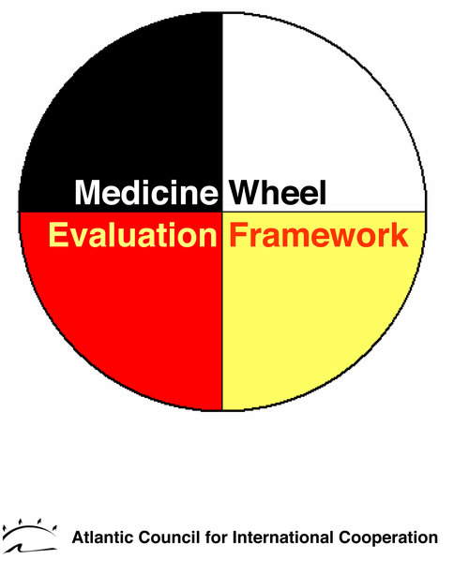
Indigenous Modernity
Central Desire
To use Indigenous Knowledge as key informing elements of the structures and processes of daily life.
Indigenous Knowledge
Indigenous Knowledge Holder/Elders

Slide 29
Indigenous Knowledge and Faculty
Recruitment
Hiring
Tenure
Evaluation
Promotion
All processes covered by collective agreement
Informed by academic tradition
Human rights legislation
Affirmative Action

Slide 30
Trent University Collective Agreement
The criteria for the granting of tenure shall be
high quality in both teaching and research, and
fulfilment of the applicable duties and responsibilities referenced in VIII 1. i) and ii).
In assessing a candidate for tenure, the Tenure Committee, COAP, the Provost, and the Board shall pay principal regard to the candidate’s scholarship and scholarly promise.

Slide 31
Written Standards for the Application of Criteria
VII.3.3.1
Individual departments will, in consultation with the Dean, formally adopt written standards for the application of these criteria for tenure, permanence, and promotion as described in this Article. The written standards are specific to the academic unit.

Slide 32
Chanie Wenjack School for Indigenous Studies Tenure Criteria
three different paths
1. Candidate with conventional academic background
2. Candidate with traditional Indigenous knowledge background
3. Dual Tradition Scholar
Latest revisions 2014

Slide 33
Appendix to Written Standards
Definitions are part of the written standards
Provide guidance to candidates who are preparing their tenure files

Slide 34
Traditional Indigenous Scholars
Traditional Knowledge
is knowledge of the language and traditional customs, rites, rituals, histories teachings of a particular group of Indigenous people or peoples.
Most people will have acquired this knowledge though active and lengthy participation in particular cultural structures and processes and a careful study and reflection of the philosophical underpinnings of them.
In many cases, they will have studied with a knowledgeable and well respected Elder.

Slide 35
Peer Assessment
Our assessment of traditional knowledge is guided by our desire to ensure peers evaluate the candidate’s traditional knowledge scholarly activity.
This peer group consists of members of the School in the usual fashion and learned members of the appropriate cultural institution to which the candidate belongs

Slide 36
Indigenous Knowledge Scholarship
Scholarly activity consists of oral presentations at workshops, seminars, lectures and/or participation in traditional ceremonies and other activities that lead to the generation of new knowledge about or within the particular field or a new field about which the candidate is knowledgeable.

Slide 37
Assessments from Elders
In case of some Elders and traditional people, it may not be possible to obtain written assessments.
We would then either visit the individual(s) personally or invite them to attend a meeting of the tenure review committee.
In the case where English is not spoken, we would arrange for an independent interpreter. In both cases, we would prepare a written text of the oral testimony.

Slide 38
Teaching
With respect to teaching, we expect that the candidate will submit the same evidence indicating teaching performance as those who are being considered for tenure in the conventional stream

Slide 39
Dual Tradition Scholar
A dual tradition scholar is an individual whose scholarship is based in and informed by principles and methods appropriate to an exploration and explication of traditional Aboriginal knowledge as well as those of the western academic disciplinary tradition.
We recognize that these two traditions involve different approaches to inquiry, method, presentation and intellectual property rights and that combining the two in an academic environment may be challenging.

Slide 40
DUAL TRADITION SCHOLAR
We also expect that elements of the two traditions of scholarship would be visible and evident in the work of a Dual Tradition Scholar. As in all scholarship, the knowledge lineage (recognized through the acknowledgement of the work of previous scholars) is visible and can be traced.
In this case, the lineage should recognize both conventional western sources as well as Elder sources. The methods of inquiry should similarly reflect the two traditions

Slide 41
DUAL TRADITION SCHOLARSHIP
The quality of scholarship is evaluated through a combination of written and oral texts that represent the findings of careful observation and reasoning.
Senior peers from all three communities (academic, Elder and Indigenous professional) evaluate this scholarship.
High-quality dual tradition scholarship is scholarship in which the knowledge lineage is clear and visible, and given the applied nature of Indigenous Knowledge is judged to make a significant practical contribution to improving the well-being of Indigenous peoples

Slide 42
DUAL TRADITION KNOWLEDGE DISSEMINATION
Knowledge dissemination consists of written and oral presentations in papers, books, chapters in books, technical and community reports, community presentations, traditional teaching workshops, ceremonial work and support, etc. as well as curriculum development.
The knowledge lineage of these activities should be made clear in order that one might see the blending as well as the dialogue between the two knowledge traditions.

Slide 43
DUAL TRADITION SCHOLARSHIP
We would consider as evidence of scholarly activity,
in addition to or complementary to those activities considered as traditional academic activities outlined previously,
an ongoing learning relationship with elders and a continued exploration of traditional knowledge as demonstrated through oral presentations and discussions at workshops, seminars, traditional teaching seminars, community presentations and the like as well as written material in the usual fashion

Slide 44
Elders
Application 1978-2020
Fred Wheatley, Anishinaabe Elder
Chief Jake Thomas, Cayuga, Haudenosaunee
Shirley Williams, Odawa, Anishinaabe
Edna Manitowabi, Odawa, Anishinaabe
Chief Doug Williams, Mississauga Anishinaabe, Director of Studies, Indigenous Studies PhD Program (LTA)
Skahendowaneh Swamp, Faith Keeper, Mohawk, Haudenosaunee (Chair in Indigenous Knowledge)

Slide 45
Dual Tradition Scholars 1978-2020
Mark Dockstator, LLD – Law and Business, Oneida
Dan Longboat, PhD – Indigenous Environmental Studies, Mohawk
Paula Sherman, PhD – History, Algonquin
Marrie Mumford, MFA, Performance, Cree-Métis
Joeanne Argue, MFA, Performance, Métis
Barb Wall, PhD, Indigenous Environmental Studies, Anishnaabe,

Slide 46
Questions
Perhaps even Answers

